Slide 1
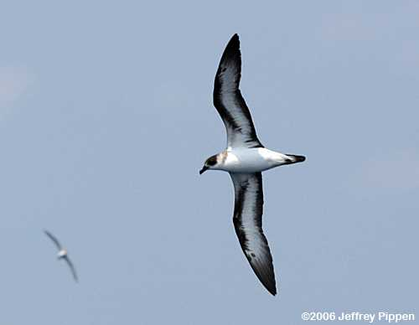

ADVANCES IN SCIENTIFIC UNDERSTANDING AND CONSERVATION OF THE BLACK-CAPPED PETREL
(Pterodroma hasitata)
DIABLOTIN
Jennifer Wheeler
On behalf of the International Black-capped Petrel Conservation Group
World Seabird Conference 2, Cape Town, South Africa; October 30, 2015

Slide 2
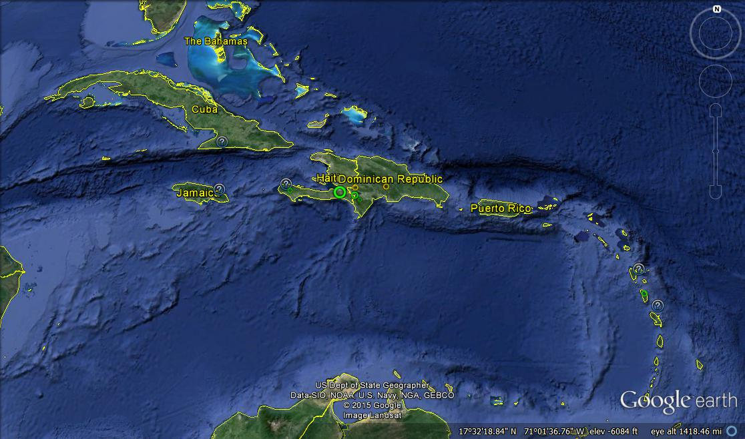
Endangered
Caribbean Endemic
Guadeloupe
Dominica
Martinique
Notes:
“Not uncommon” to abundant seabird on multiple Caribbean islands when first described in writing -- Cuba, Jamaica (separate species), Puerto Rico? Guadeloupe, Dominica, Martinique.
Like most Pterodroma, nesting populations of P. hasitata are found along the edges of oceanic fault plates. Not only is the species is endemic to the Caribbean, but nesting colonies are confined to islands on the northern and eastern edge of the Caribbean plate, Jamaica being the exception.
Like many other seabirds in the region, populations of Black-capped Petrels today represent isolated relicts of larger and more widely distributed colonies. Colonies have been reduced to a few sites on cliffs and isolated cays that were inaccessible to humans and introduced predators. By the time the earliest natural history writers reported on the West Indies, all known colonies had been subject to heavy exploitation.
Their disappearance documented throughout the 1800s, mostly disappeared by the turn of the century, with a few observations scattered into the early 1900s. But essentially, GONE by early 1900s.
Re-discovered in Hispaniola in 1963
At sea concentrations in 1970s and 1980s
Multiple expeditions in the Caribbean in recent decades
Active petrel nest discovered March 2011
Hispaniola field research and conservation activities:
Conservation Action Plan 2012
Guess at numbers 500 to 1000 pairs???…. Chick just found!

Slide 3
Endangered
Caribbean Endemic
Historic records on 6 islands
Disappeared late 1800s/1900s
Colony re-discovered in Haiti 1963, subsequent expeditions found more aggregations; 2001 first nest; 2011 first chick
Radar surveys on Hispaniola 2012-2014
  Identified flyways and potential nesting areas, index to abundance
  Ongoing nest searching, nest monitoring and collection of vocalization data
  Radar surveys on Dominica 2015
  Confirmed nesting activity on a second island
  Collection of vocalization data underway
  Nest searching planned
Notes:
Caribbean endemic; historic records from 6 islands, fossils on another
Winked out in late 1800s, early 1900s due to human overconsumption, loss of habitat, and introduced predators.
Rediscovered in Haiti 1963, expeditions on Hispaniola in subsequent decades found multiple aggregations of vocalizing petrels; in 2001 first active nest found; in 2011 first nest monitored
Radar surveys on Hispaniola 2012-2014 identified flyways and potential nesting areas and provided index to abundance; nest searching, nest monitoring and collection of vocalization data continues
Radar surveys on Dominica 2015 confirmed nesting activity on a second island; collection of vocalization data underway; nest searching planned.
Expeditions by Wood, Simons, Goetz

Slide 4
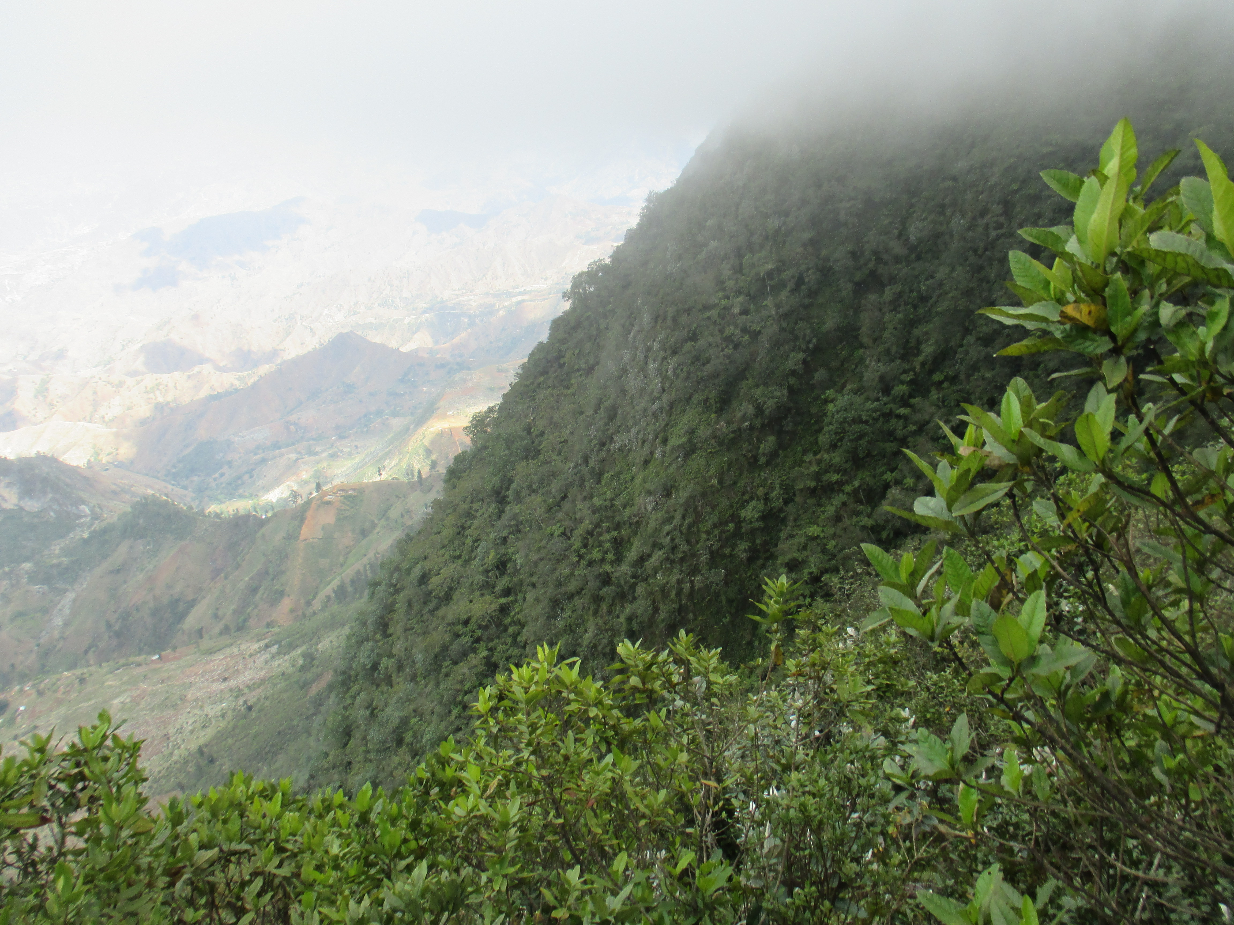
Situational Analysis/Threats

Slide 5
Situational Analysis/Threats
Still seeking petrels
  Total radar targets Hispaniola = 4550
  Total radar targets Dominica = 968
  ~90 nests mapped on Hispaniola; searching far from complete
Vulnerable due to small global population; still characterizing direct threats
Most important area known (LaVisite, Haiti) is highly threatened by encroachment (agriculture, livestock, forest product collection)
Encroachment and/or fire are major threats on other Hispaniola sites
Capacity for engagement limited; human livelihood challenges, esp. in Haiti

Slide 6
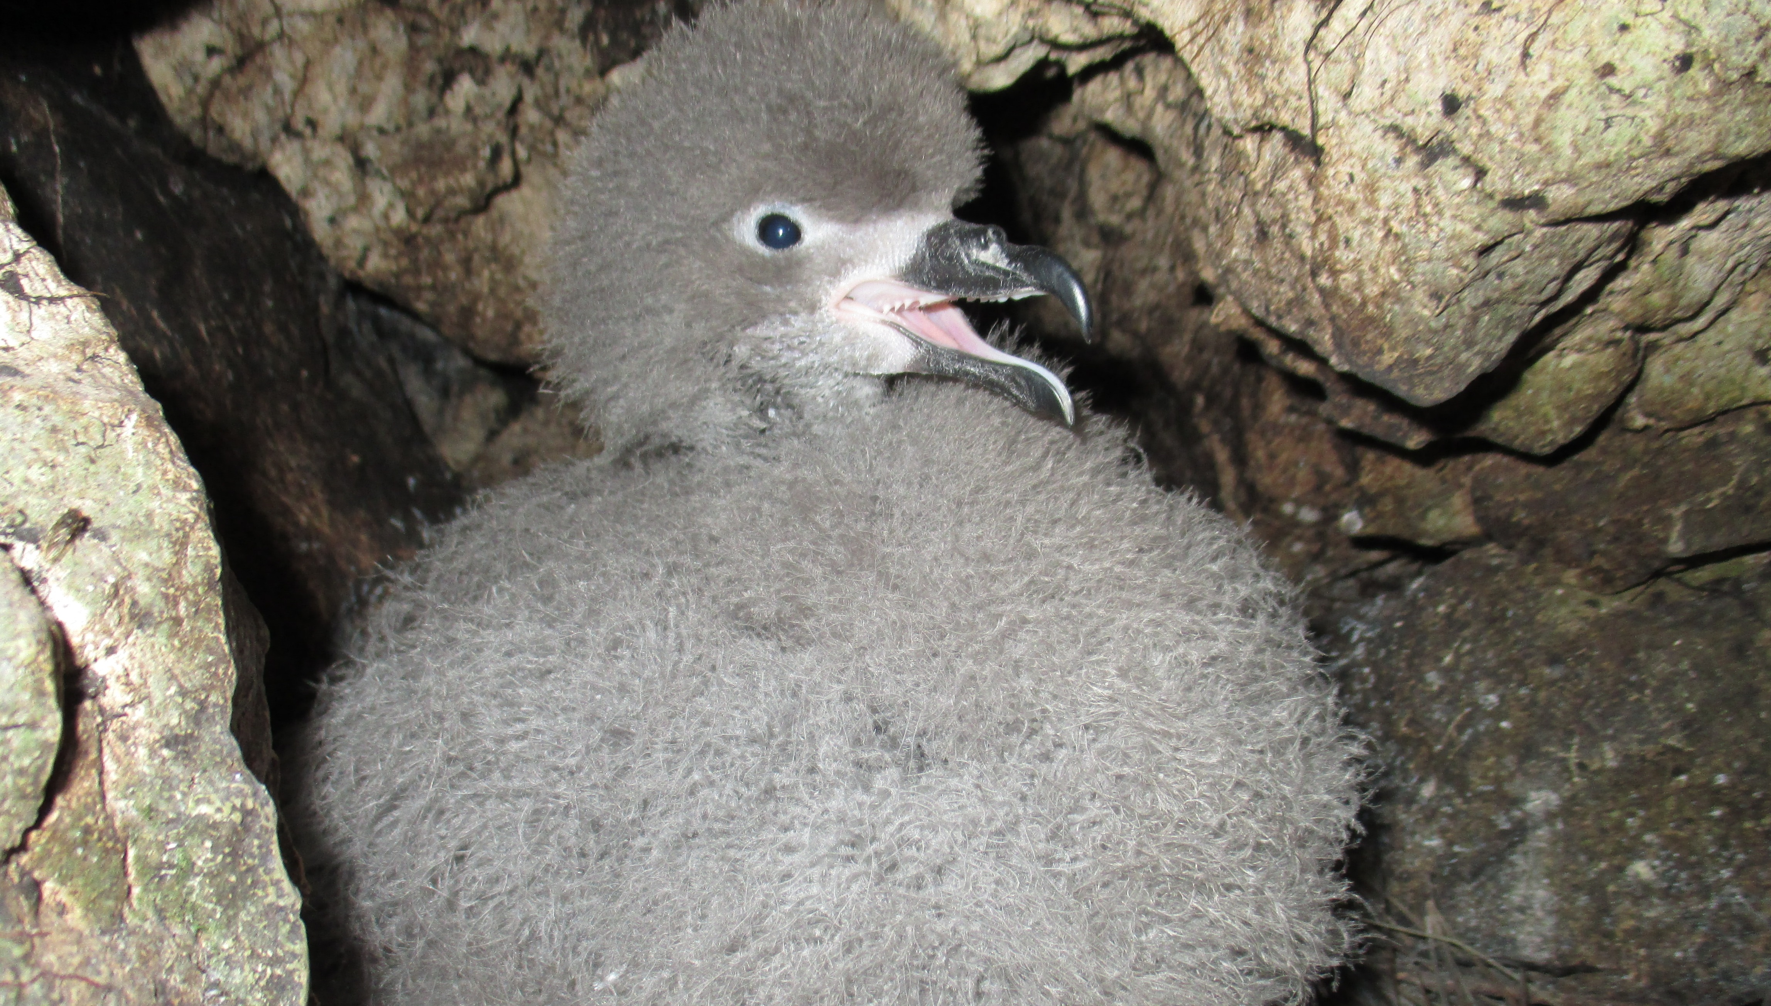
Advantages
Notes:
Charisma of optimism?

Slide 7
Advantages
Compelling conservation story; determined biologists
U.S. funding for a non-breeding species
  Public and private sources
Predation rates seem surprisingly low
Dominica offers promise of well-protected forests
Notes:
Charisma of optimism?

Slide 8
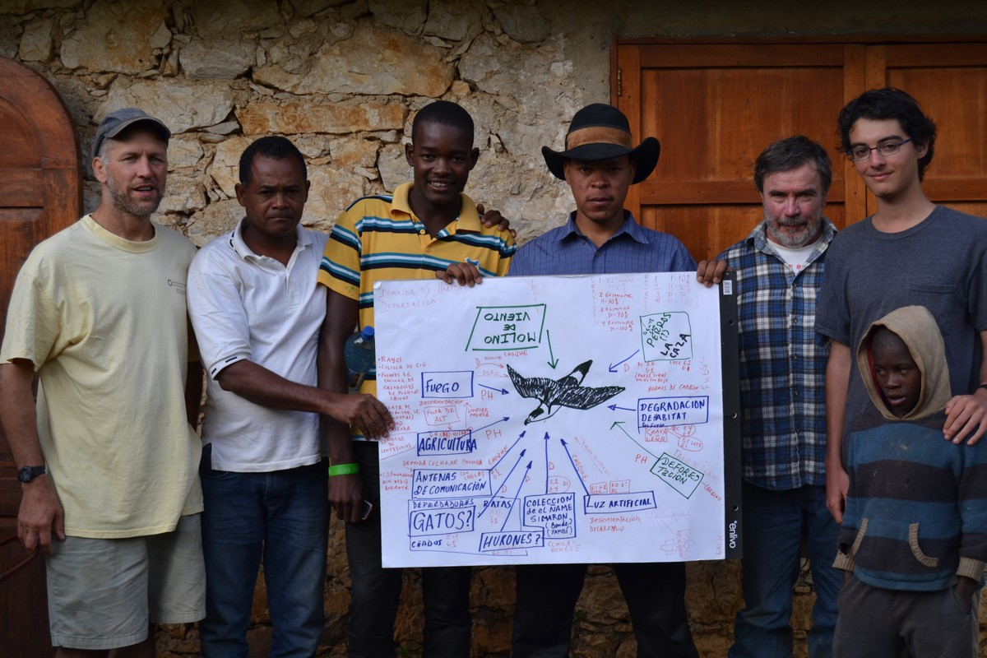
Approaches

Slide 9
Approaches
Dogged determination; a gathering of momentum
Technology
  Marine radar/infrared imagery/night-vision; ARUs; satellite telemetry
Training/Capacity Building
  Haitians join DR teams
  DR teams to Dominica
  Institutional capacity-building
  Encouraging youth
  Securing Government Support
    International conventions: SPAW, CBC, CMS
    U.S. ESA

Slide 10
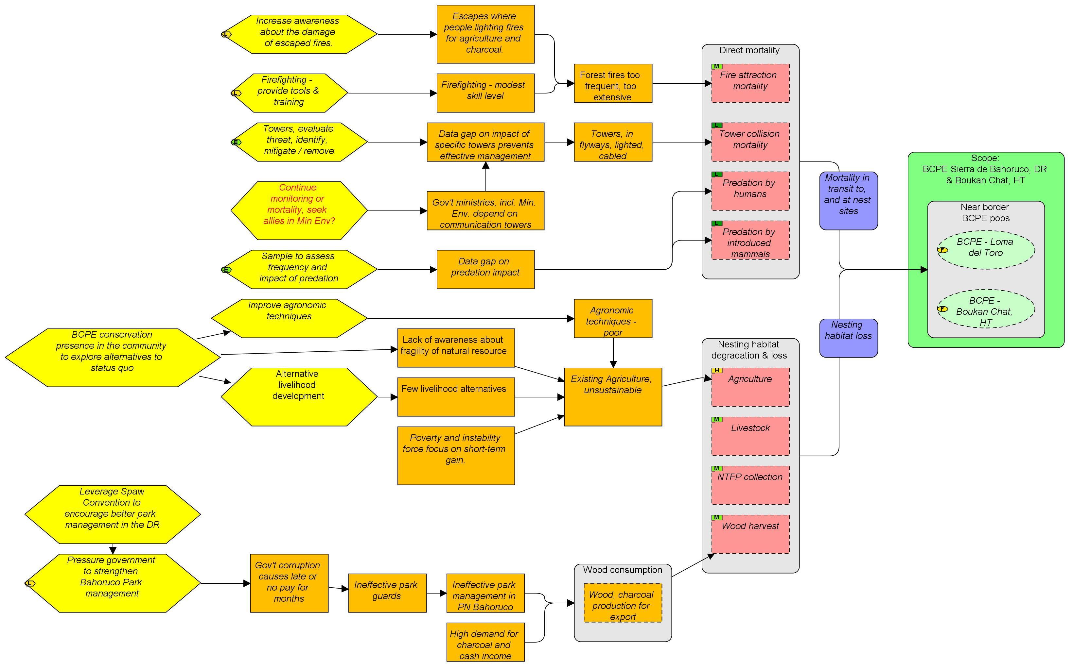
Evolution of Planning

Slide 11
Evolution
of Planning
2012 Conservation Plan increases visibility, coalesces effort
Encouraging regular dialogue between active partners
Keeping broader community apprised
2013-present: Open Standards for the Practice of Conservation
Multi-species integration?

Slide 12

Acknowledgements
Co-Authors:
Adam Brown, Environmental Protection in the Caribbean
Jim Goetz, Cornell University; GIZ; VCE
Anderson Jean, Societe Audubon Haiti
Patrick Jodice, USGS/Clemson University
Matthew McKown, Conservation Metrics Inc.
Ernst Rupp, Grupo Jaragua
George Wallace, American Bird Conservancy
Many other partners, donors and supporters
Notes:
Well, there’s so much more to share, but I’m out of time.
In closing, I’d like to state again that I am primarily a mouthpiece for a grop of extremely collaborative people who have been working on advancing the science and conservation of the Diablotin.
The logos here represent the individuals who contributed content for this presentation. Work on behalf of the Diablotin has been supported by many others.
Thank you.

